Slide 1
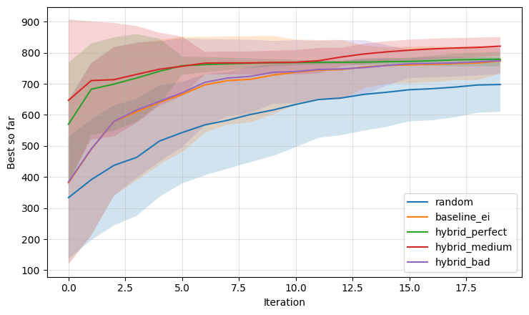
100 Trial Repeats

